Slide 1
Looking For Bussiness opportunity in Brazil
Guilherme Oliveira

Slide 2
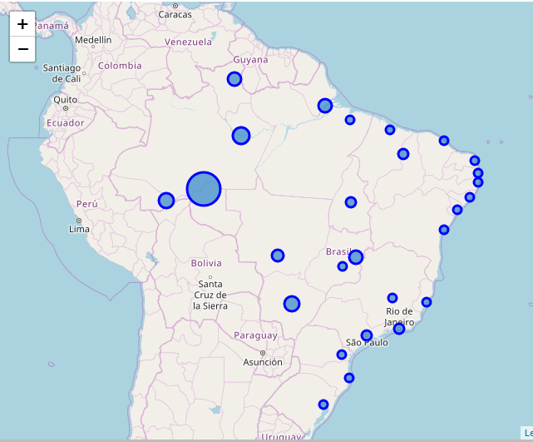
The country
27 States
5 Geografic Regions
Area of 8.511.000 km²
9th World Economy

Slide 3
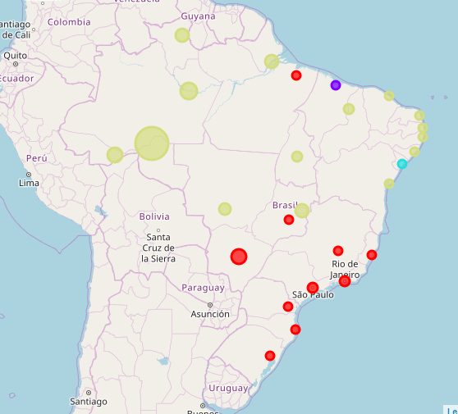
Understanding how to analyse
Criterea: Most Common Venues in each city
Considered range: Capital Cities of each State
Algorithm: K-means
Smaller Clusters considered as outliers

Slide 4
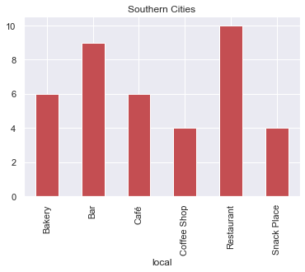
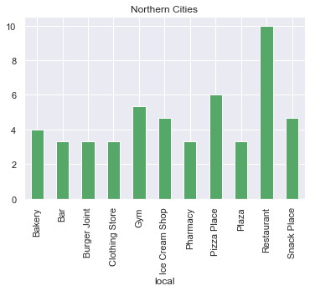
Main Clusters

Slide 5
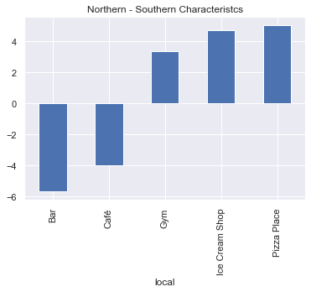
Presence of Bars in the southern class as the Strongest divergent characteristic

Slide 6
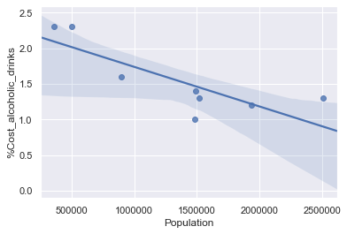
Exploring correlation
Population x Weight of the average expense on beer an other alcoholic drinks
Cities with similar population size
One city (Porto Alegre) was considerably out of the confidence range of the calculated model

Slide 7
Conclusion
Considering it similarity with other Capitals and a much lower percentual expense on alcoholic drinks, Porto Alegre is a potential focus for the development of Business related to this kind of Beverage.

